Slide 1
Semantic MEDLINE
A Web Application for Managing the Results of PubMed Searches
Halil Kilicoglu
Marcelo Fiszman
Alejandro Rodriguez
Dongwook Shin
Anna M. Ripple
Thomas C. Rindflesch
- Dixita Patel

Slide 2
Overview
What the paper is about : Need for new approach
Understanding the new approach : Semantic MEDLINE
It’s implementation : Architecture and UI
Detail explanation taking one use case
Evaluation of system
DEMO

Slide 3
What the paper is about?
It is about Semantic Medline, a web application that:
Manages the results of PubMed searches by Summarizing and Visualizing semantic predicates extracted from MEDLINE citations.
Linking results to several structured resource to provide an integrated environment.

Slide 4
Need for new approach
Traditional information retrieval tools often challenge users with the large number of items returned.
PubMed provides access to over 17 million citations from 5000 journals in the MEDLINE database.
Which one to read!!

Slide 5
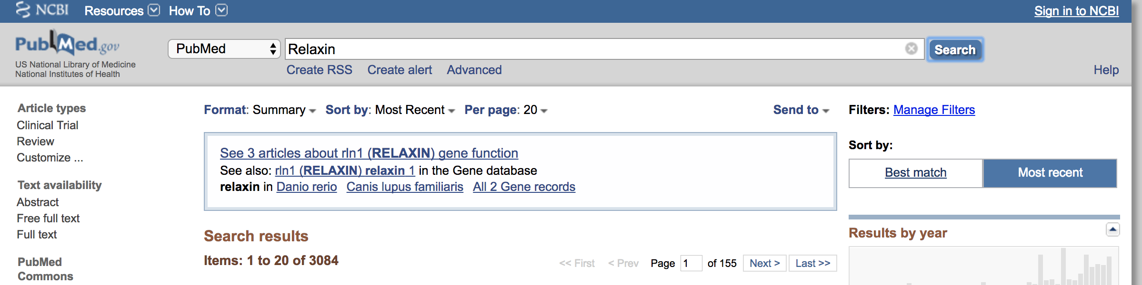
Managing the search results
Retrieval
Summarization
Network of relations
500 citations
Information retrieval
Semantic MEDLINE

Slide 6
Solution: Seamless integration of technologies
Information Retrieval
From PubMed search using MEDLINE database.
Natural Language Processing (SemRep)
Representing text in semantic predicates form.
Automatic summarization
Informative overview of the most relevant information.
Visualization
Indicative link to source text and information with the help of graph.

Slide 7
Understanding basic terminologies
MEDLINE
Bibliographic database of life science and biomedical information.
PubMed
Free search engine accessing primarily the MEDLINE database.
U.S National Library of Medicine (NLM) at National Institute of Health maintains the Database.

Slide 8
Semantic MEDLINE: Working
Text
Semantic Predications
Salient Semantic Predications
Informative Graph
Query
PubMed
SemRep
Summarize
Visualize
By user
MEDLINEDB
UMLS
Structured Biomedical Data

Slide 9
Core components of Semantic MEDLINE
SemRep:
Extracts semantic predication (subject-predicate-object triples) from text.
This uses domain knowledge provided by UMLS (Unified Medical Language System), which integrates and distributes key terminology, classification and coding standards.
It represents textual content with semantic predications consisting of UMLS Metathesauras concepts as arguments and UMLS Semantic Network relations as predicates.
Example
aromatase inhibitor provides mortality benefit in early breast carcinoma
Aromatase Inhibitors
TREATS
Breast cancer

Slide 10
Core components of Semantic MEDLINE
2. Automatic summarizer:
SemRep predications from multiple documents provide input to Semantic MEDLINE summarizer, which provides a reduced and focused list of predications (“Semantic condensate”)
Condensation are based on:
User selected topic
Summarization perspective (Treatment of Disease, Substance Interactions, Diagnosis).
Semantic condensation is guided by 4 principles:
Relevance: Include those that are relevant to selected topic.
Connectivity: Include additional useful predications.
Novelty: Eliminate, using UMLS hierarchy information, the predications the user already knows.
Saliency: Eliminate predications with low frequency of occurrence.

Slide 11
System Implementation
Semantic MEDLINE is implemented as a three tier, Java EE- based Web application, which allows separation of user interface, application logic and data storage.
The application runs in a Tomcat servlet container on an Apache http server and has been developed using the Apache struts web application framework.
This encourage the use of the MVC(Model-View-Controller) paradigm to provide a clean separation of application model, navigational code and page design code through use of Java Servlet API.

Slide 12
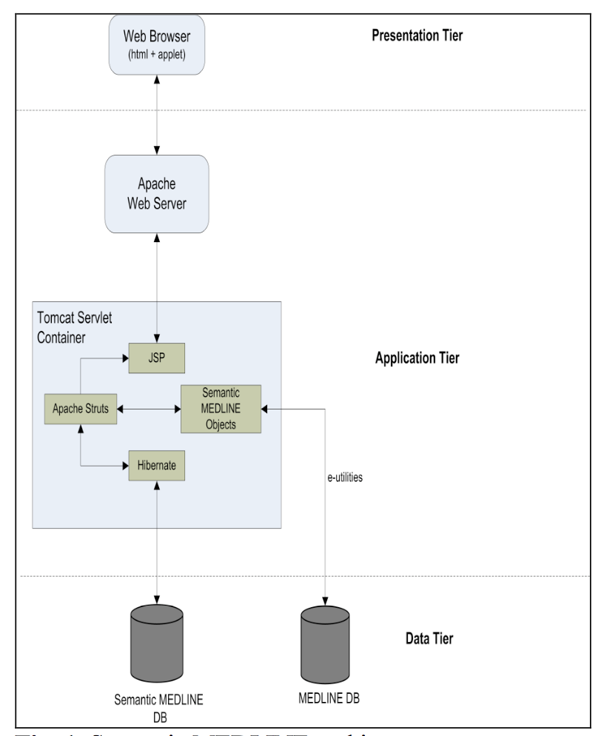
Semantic MEDLINE architecture

Slide 13
User Interface
Semantic MEDLINE has 4 tabs:
Search
It allows the user to specify query and set PubMed limits. Results can be saved in XML format for later reuse.
SemRep
Presents predications extracted from citations retrieved.
Summarization
To select topic and perspective.
Visualization
Provide access to the graph representing the summarized semantic condensate.

Slide 14
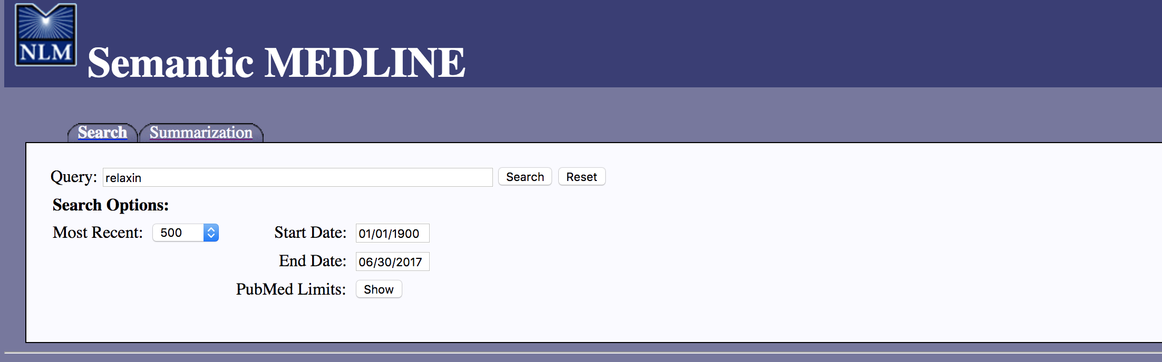
UI screenshot

Slide 15
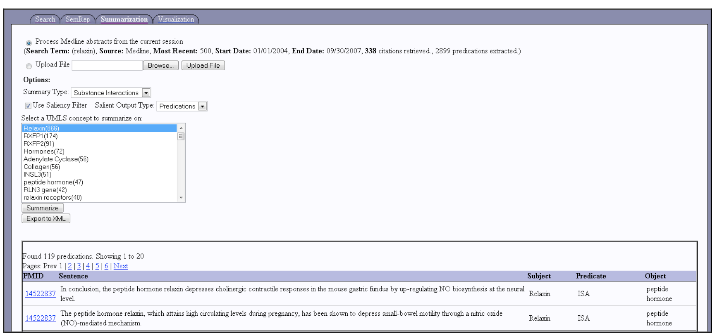
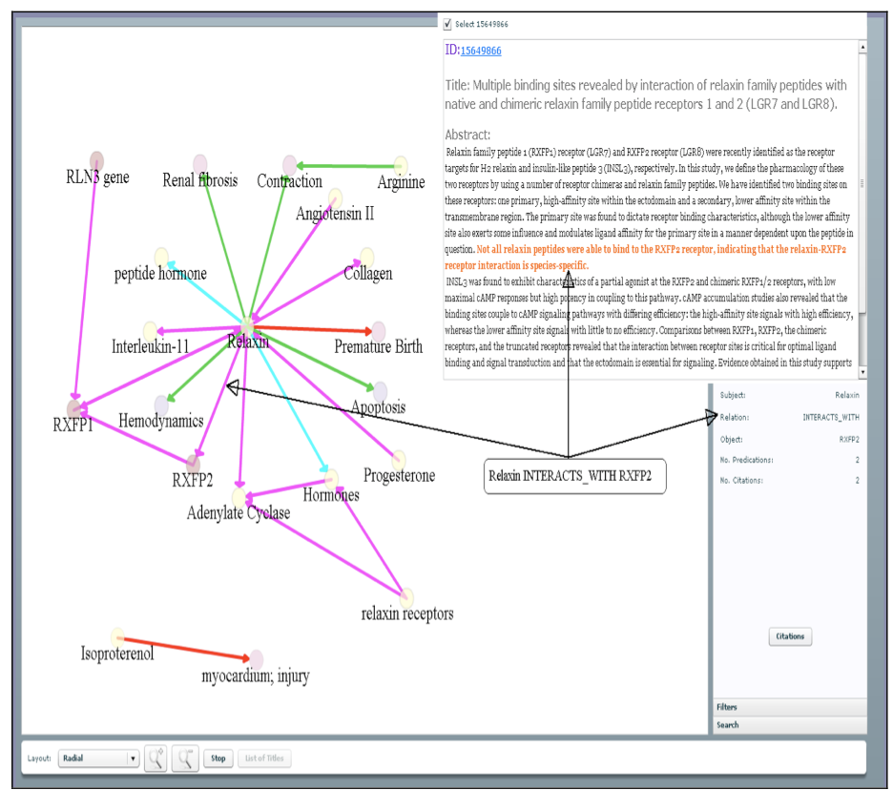
Summarization
Visualization

Slide 16
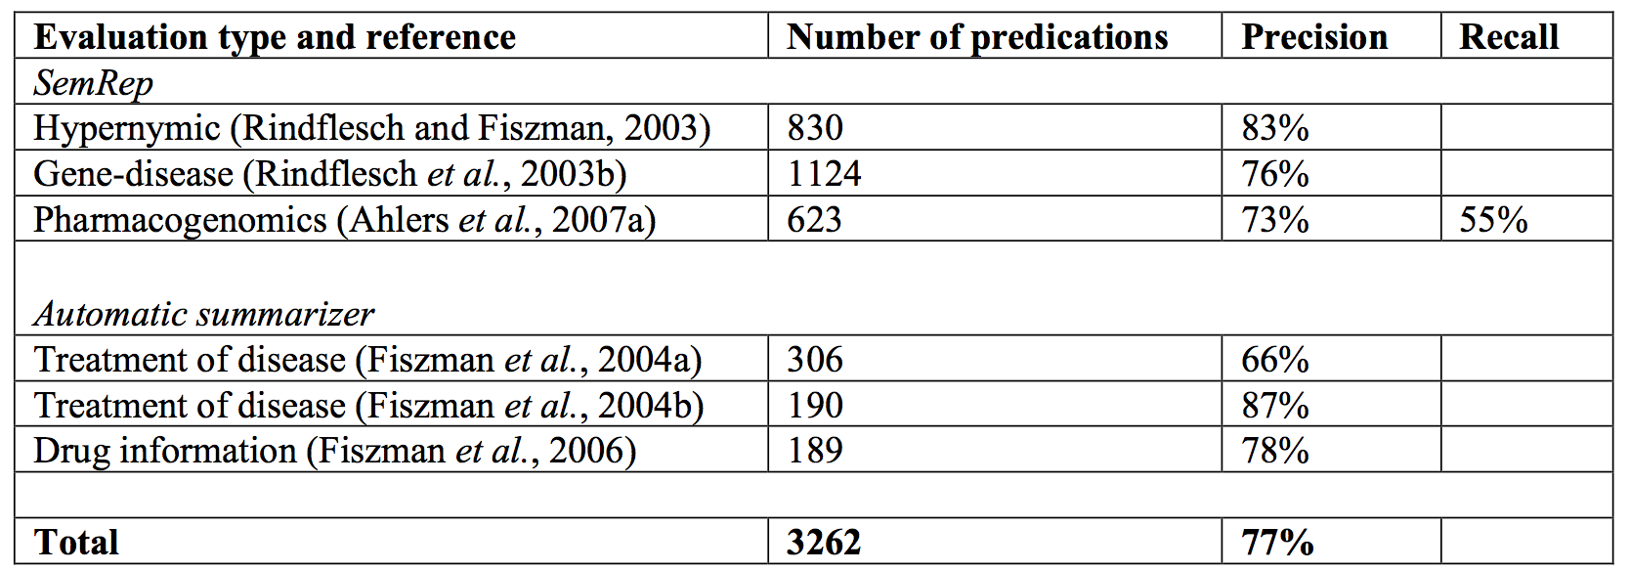
Evaluation
Accuracy of SemRep is crucial to overall effectiveness of Semantic MEDLINE.
A summary of prior evaluations of SemRep and the automatic summarizer is as follow:
IsA
Cause,Predispose
Disrupts, Inhibits

Slide 17
Current work
They are still in process of scaling the system without compromising performance.
One challenge is to keep relevant data up-to-date, UMLS database and MEDLINE database.
Putting in place procedures to automate data updating.
They are also exploring the extension of Semantic MEDLINE to support additional health related textual database.
Evaluating user interface which will improve overall effectiveness of the application.

Slide 18
Pros and Cons
Pros:
The paper was discussed using proper subsections.
Once we get the catch of the terms and flow, it was easy to understand.
Cons:
Paper assumed that the reader might be knowing about PubMed, MEDLINE, UMLS. So, it took time to get the terms at place.
It lacked the application working diagram, which I think that the diagram of the flow might have helped to understand the system fast.

Slide 19
THANK YOU

